Slide 1
How Your Digital World Really Works
Steve
Schofield
Cables
Your Phone
The Internet

Slide 2
Warm-Up Activity: Tech in Your Life
Think about the technology you use every day:
• What’s the FIRST device you used today?
• What device do you use the MOST?
• Which device would be the HARDEST to live without?

Slide 3
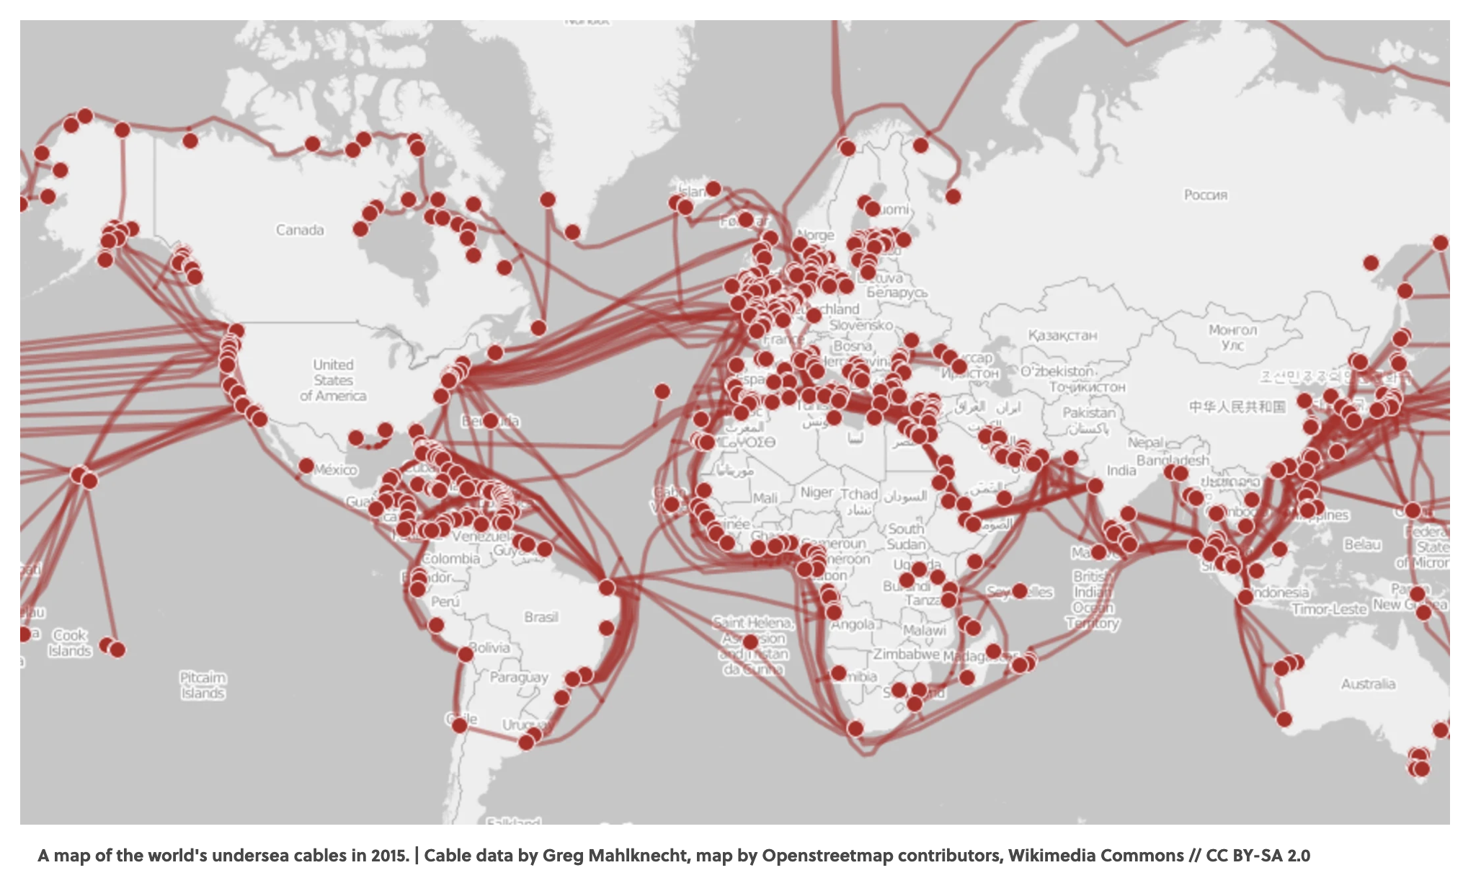
Internet sea cables
https://www.submarinecablemap.com/

Slide 4
Why Cables Matter
Cables carry:
Power
Data
Video
Sound
Internet
No cables = no technology

Slide 5
USB Cables
Universal Serial Bus
Used for charging, transferring files, and connecting devices.
USB-C works both directions and can carry power, data, and video.

Slide 6
HDMI
High-Definition Multimedia Interface
Used for game consoles to TVs and laptops to monitors.
Carries video and audio.

Slide 7
Fiber / Ethernet Cable
Fiber sends light or Fiber Optic
Used for wired internet.
Faster and more stable than WiFi.
Even WiFi routers use Ethernet behind the scenes.

Slide 8
Coax Cable
Used for wired internet.
Hookups up modems / routers from Internet provider

Slide 9
Big Idea (Cables)
Cables are the roads that data travels on.
HDMI
Coax
Fiber
Ethernet
USB

Slide 10
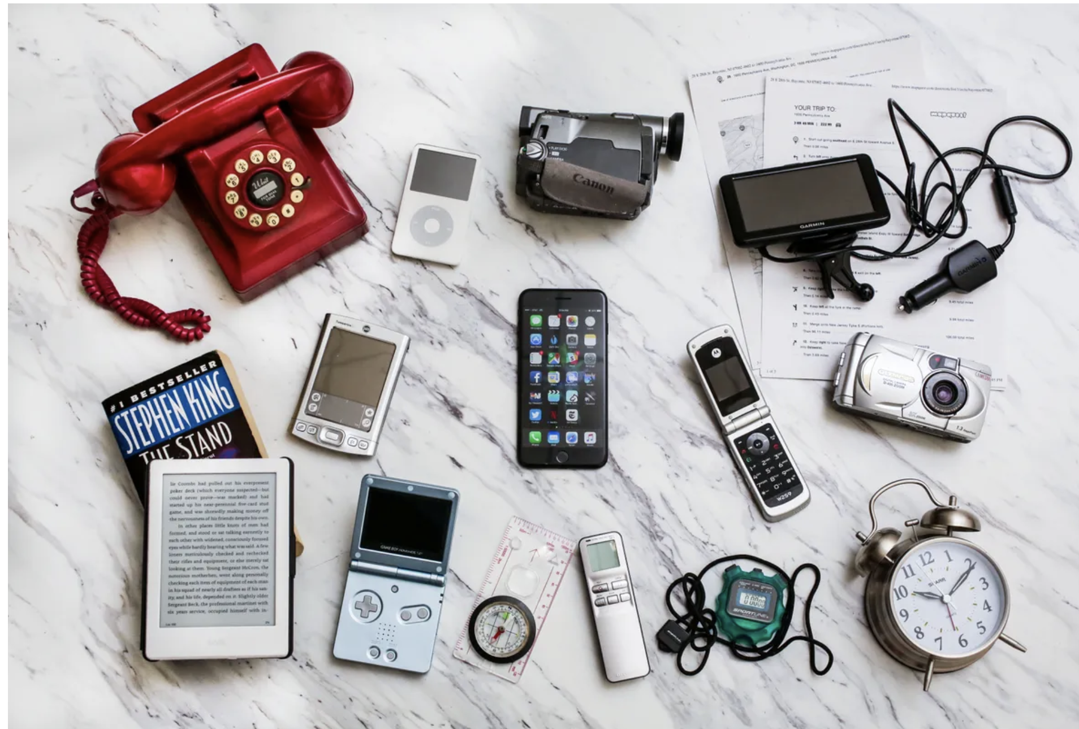

Slide 11
Your Phone Is a Tiny Computer
What things did the phone replace?
Flashlight
Alarm Clock
Your phone contains a brain, memory, storage, power, and sensors.
What components does your phone have?

Slide 12
CPU (The Brain)
Central Processing Unit
Runs apps, games, and processes videos.
Faster CPU = smoother performance.
Antennia = connects to cellular (wifi)

Slide 13
RAM (Short-Term Memory)
Random Access Memory
Helps run multiple apps and switch between them.
More RAM = fewer slowdowns.

Slide 14
Storage (Long-Term Memory)
Holds photos, videos, messages, and apps.
Full storage can slow your phone.

Slide 15
Sensors
Camera, Microphone, GPS, Motion sensors, Face/Fingerprint ID.

Slide 16
What If Your Phone Breaks?
Would you lose photos, contacts, or school files?
This is where backups matter.

Slide 17
What Is a Backup?
A backup is a copy of your data stored somewhere else.
Cloud backups protect your info.

Slide 18
Big Idea (Phone)
Your phone creates and stores your digital life.

Slide 19
The Internet Isn’t Magic
ISP - Internet Service Provider
When you open an app, your phone connects to servers somewhere else.

Slide 20
What Is a Server?
A powerful computer that stores websites, runs apps, streams videos, and saves cloud data.

Slide 21
What Is a Data Center?
WAN - Wide Area network
A building full of servers with cooling, power backup, and network connections.

Slide 22
When You Use the Internet…
Streaming, gaming, cloud storage, and online apps all use data centers.
Your phone connects through cables and WiFi or Cellular to data centers around the world.

Slide 23
Final Wrap-Up
Cables move the data.
Phones create the data.
The Internet stores and shares the data.

